Slide 1
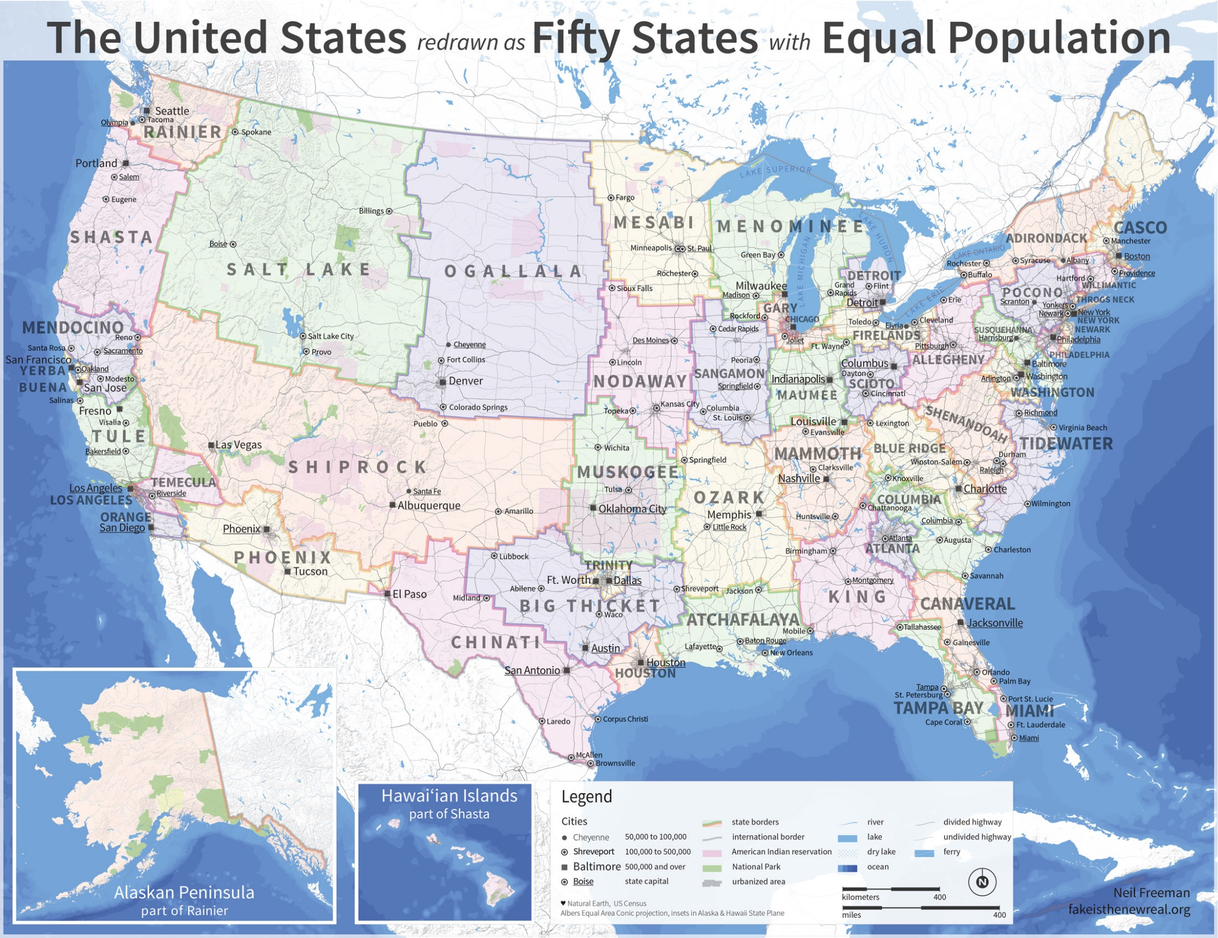

Slide 2
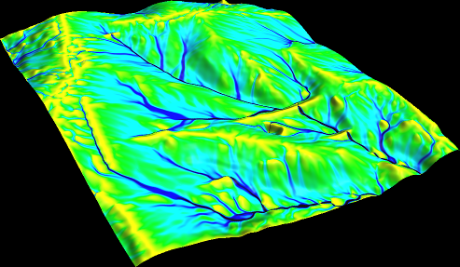
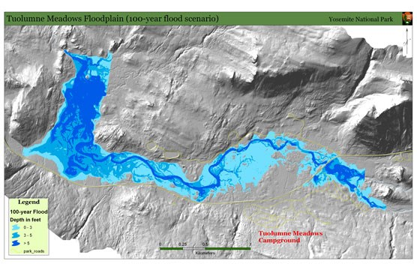
Hydrology
Notes:
Akpoti, K.; Antwi, E.O.; Kabo-bah, A.T. Impacts of Rainfall Variability, Land Use and Land Cover Change on Stream Flow of the Black Volta Basin, West Africa. Hydrology 2016, 3, 26.

Slide 3
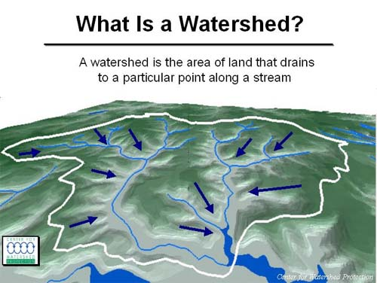
.
“However the drawing of blue lines on maps usually involves some subjective judgement by the cartographer”
Tarboton, D. G., R. L. Bras, and I. Rodriguez–Iturbe. 1991. "On the Extraction of Channel Networks from Digital Elevation Data." Hydrological Processes 5: 81–100.

Slide 4
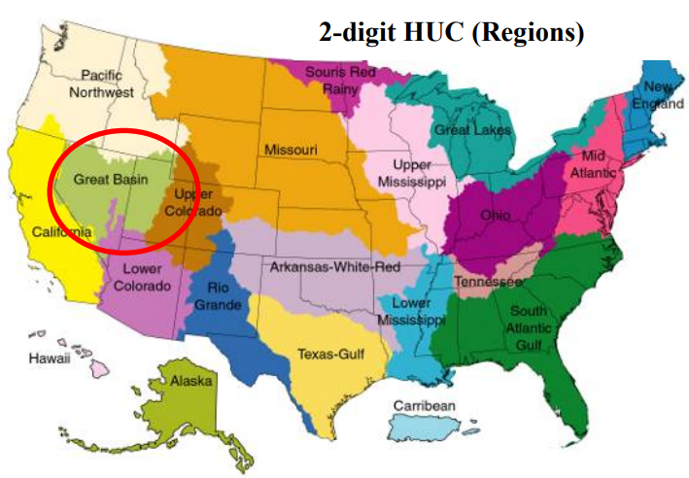
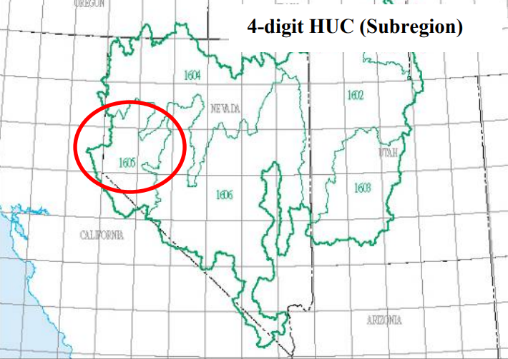
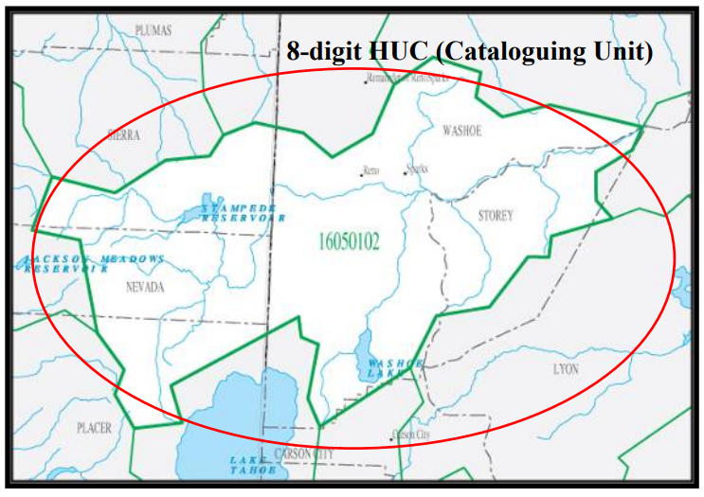
HUC Units
Unique ID for CONUS et al. watersheds
2-digit HUC first-level (region)
4-digit HUC second-level (subregion)
6-digit HUC third-level (accounting unit)
8-digit HUC fourth-level (cataloguing unit)
10-digit HUC fifth-level (watershed)
12-digit HUC sixth-level (subwatershed)

Slide 5
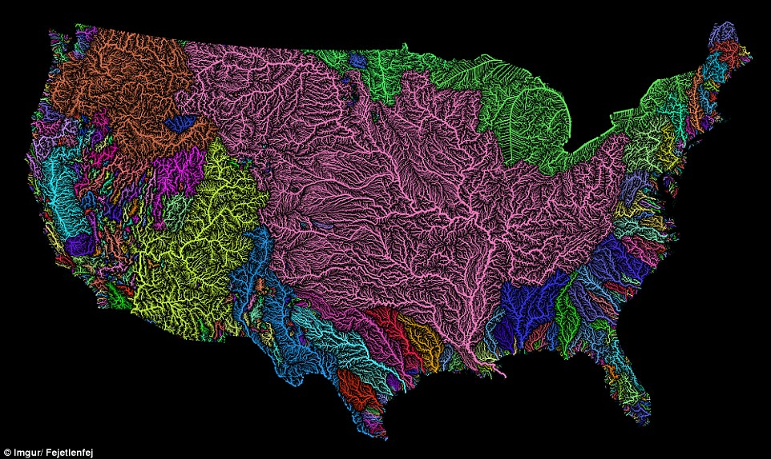
Basin
The drainage basins are delineated within the analysis window by identifying ridge lines between basins.

Slide 6
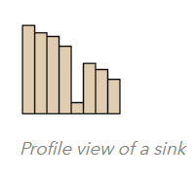
Sink
A sink is a cell or set of spatially connected cells whose flow direction cannot be assigned one of the eight valid values in a flow direction raster. This can occur when all neighboring cells are higher than the processing cell or when two cells flow into each other, creating a two-cell loop.
The Sink tool only supports a D8 input flow direction raster. D8 flow directions can be created using the Flow Direction tool, run with default flow direction type D8.

Slide 7
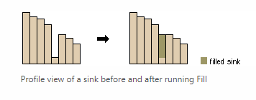
Fill
Sinks (and peaks) are often errors due to the resolution of the data or rounding of elevations to the nearest integer value.
Sinks should be filled to ensure proper delineation of basins and streams. If the sinks are not filled, a derived drainage network may be discontinuous.
For 30-meter resolution DEMs, Tarboton et al. (1991) found that from 0.9 to 4.7 percent of the cells in a DEM were sinks.
The mean adjustment of these sinks ranged from 2.6 to 4.8 meters. This means that for a 1,000 by 1,000 cell grid (1 million cells), there may be 9,000 to 47,000 sinks to be filled.

Slide 8
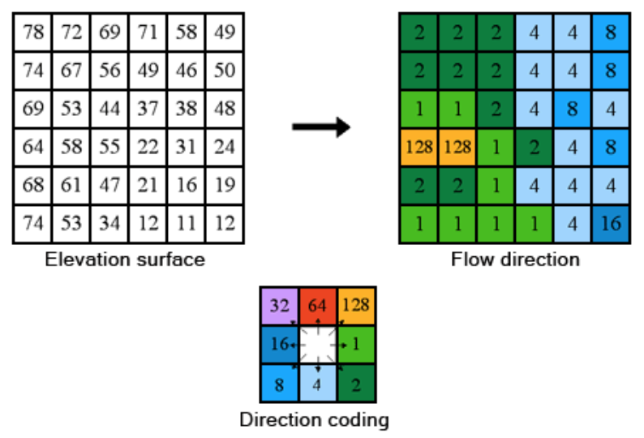
Flow direction
.

Slide 9
Flow Length
Calculates the upstream or downstream distance, or weighted distance, along the flow path for each cell.

Slide 10
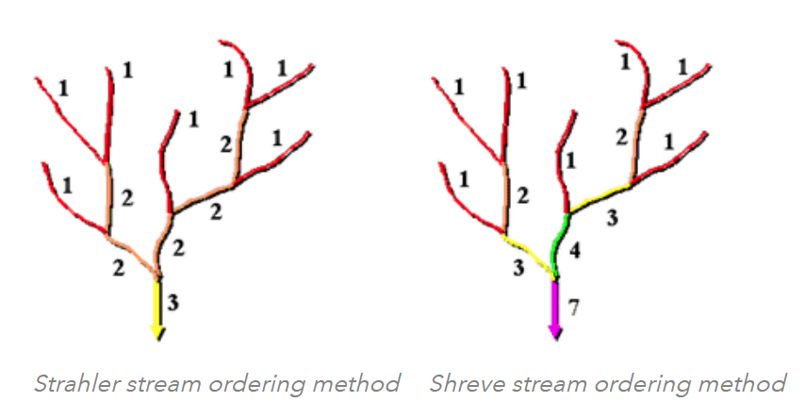
Stream order
.

Slide 11
Stream to Feature
vectorization of stream networks or any other raster representing a raster linear network for which directionality is known.
This is in contrast to the Raster To Polyline tool, which is generally more aggressive with collapsing the lines together.

Slide 12
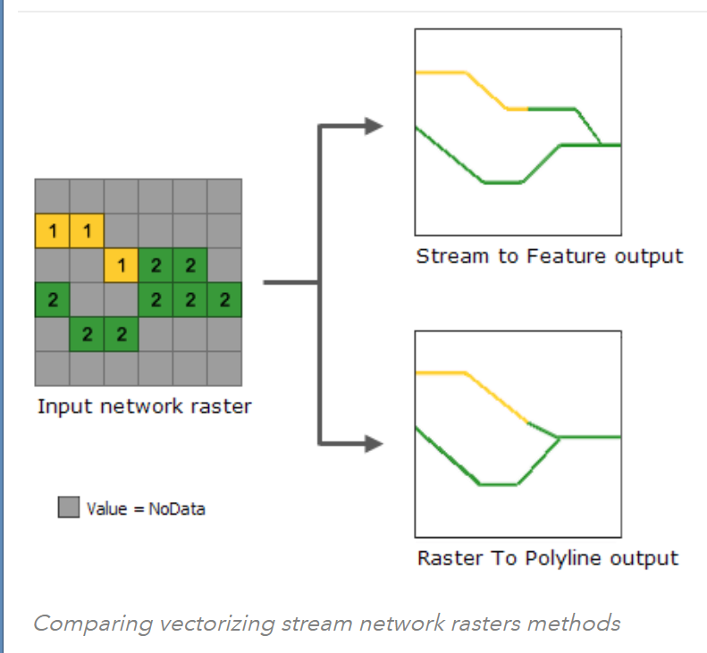
Stream to Feature

Slide 13
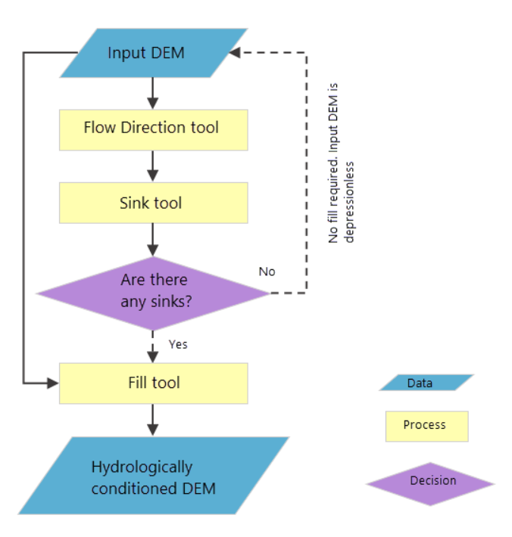
.

Slide 14
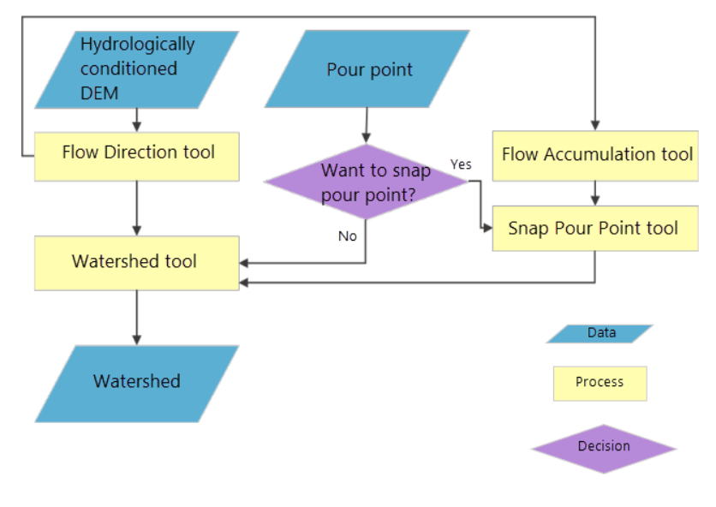
.

Slide 15
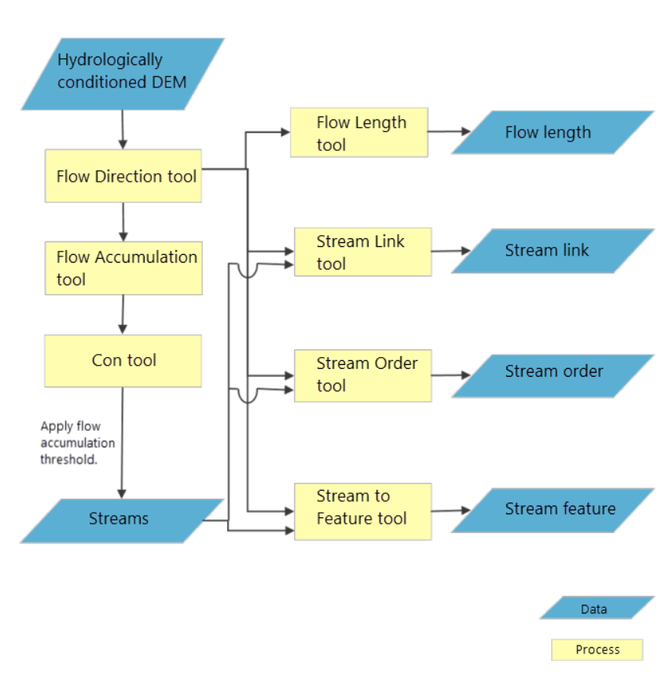
.
Notes:
Akpoti, K.; Antwi, E.O.; Kabo-bah, A.T. Impacts of Rainfall Variability, Land Use and Land Cover Change on Stream Flow of the Black Volta Basin, West Africa. Hydrology 2016, 3, 26.

Slide 16
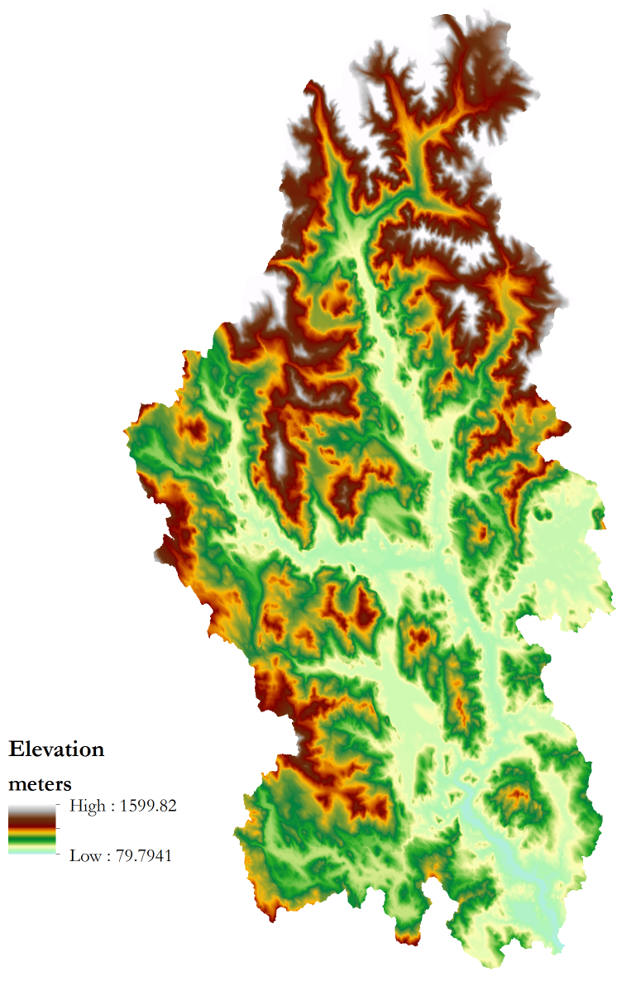
Example: General Processing
.

Slide 17
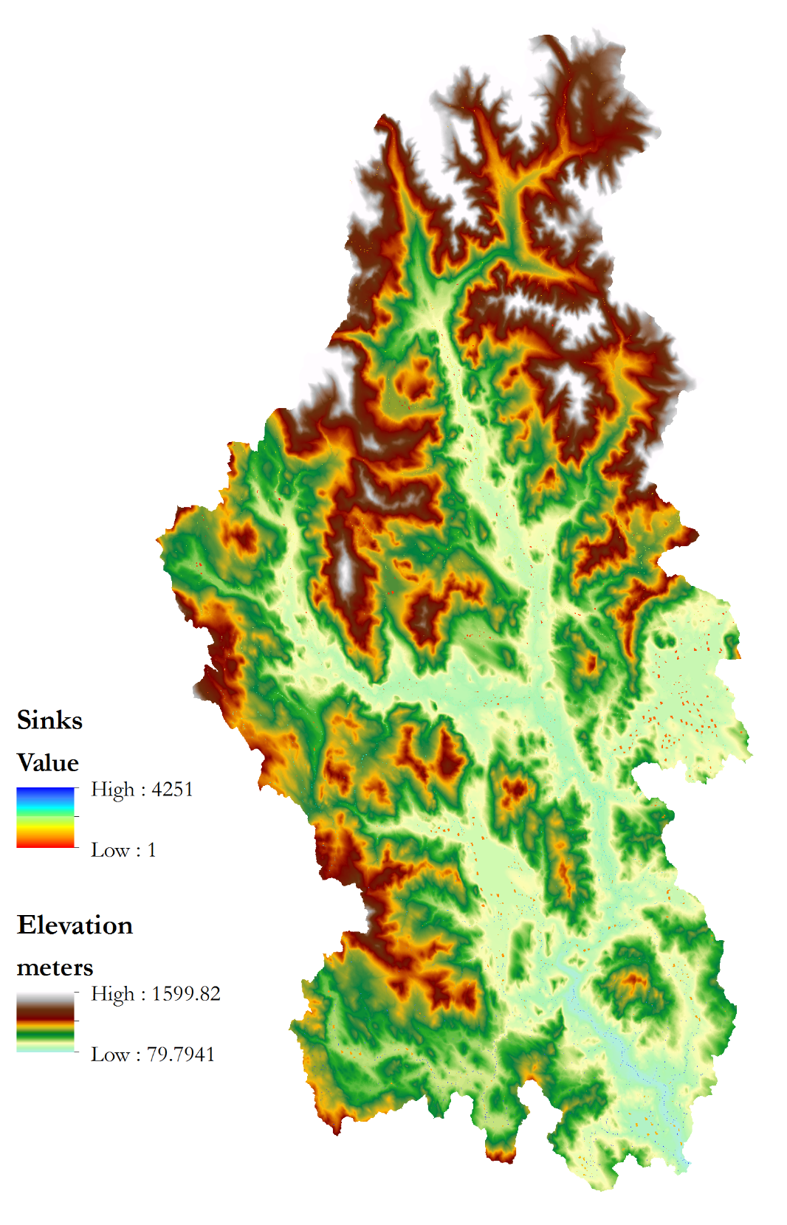
.

Slide 18
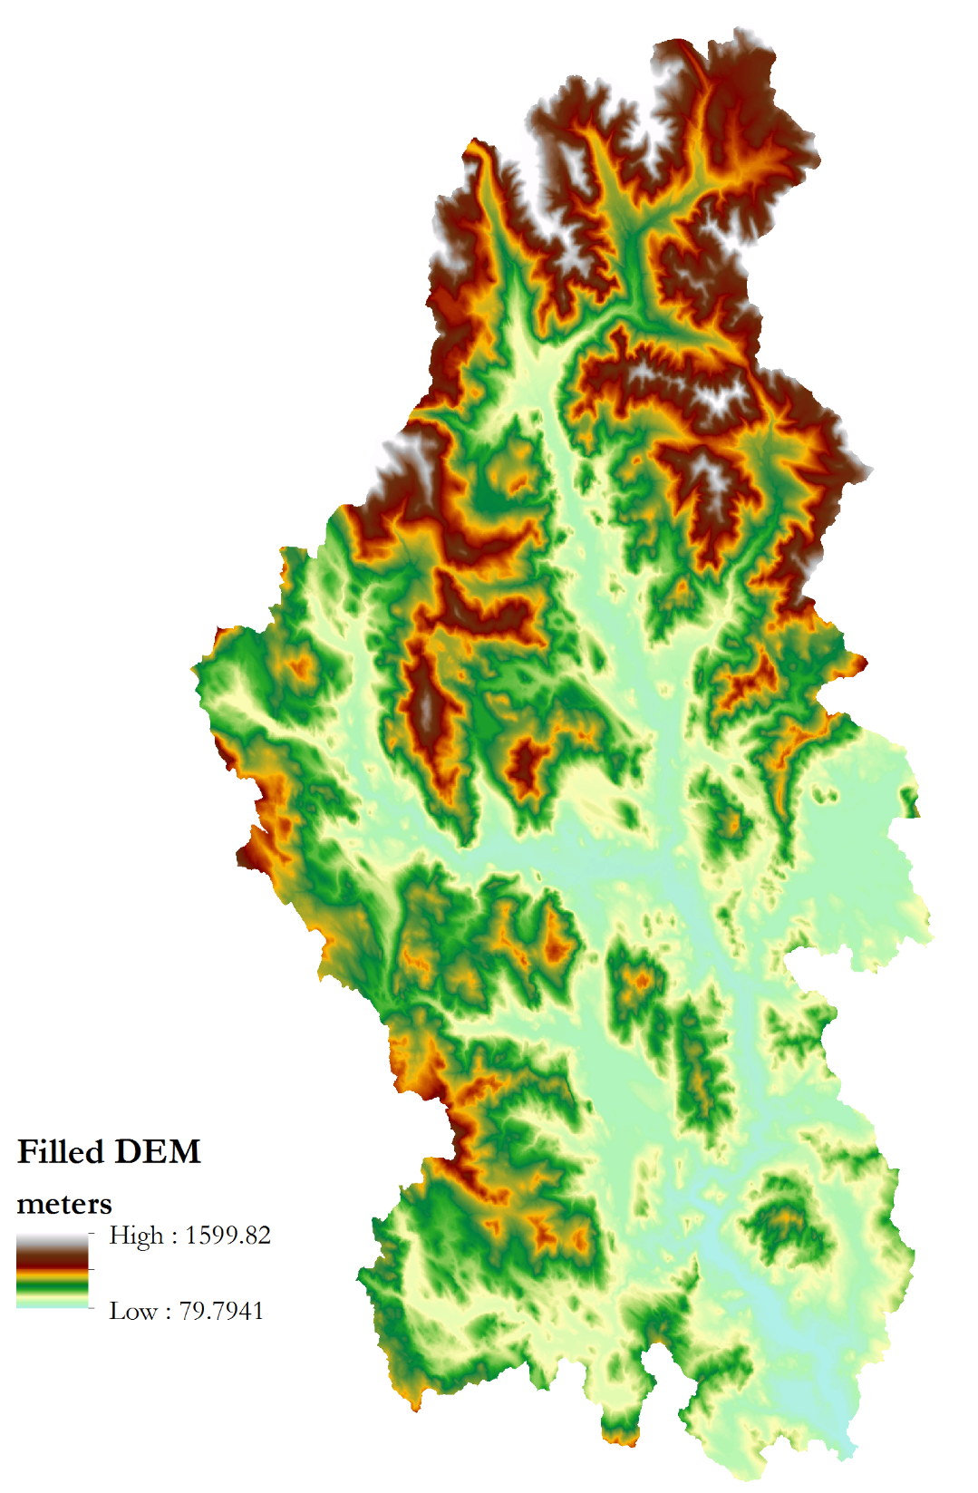
.

Slide 19
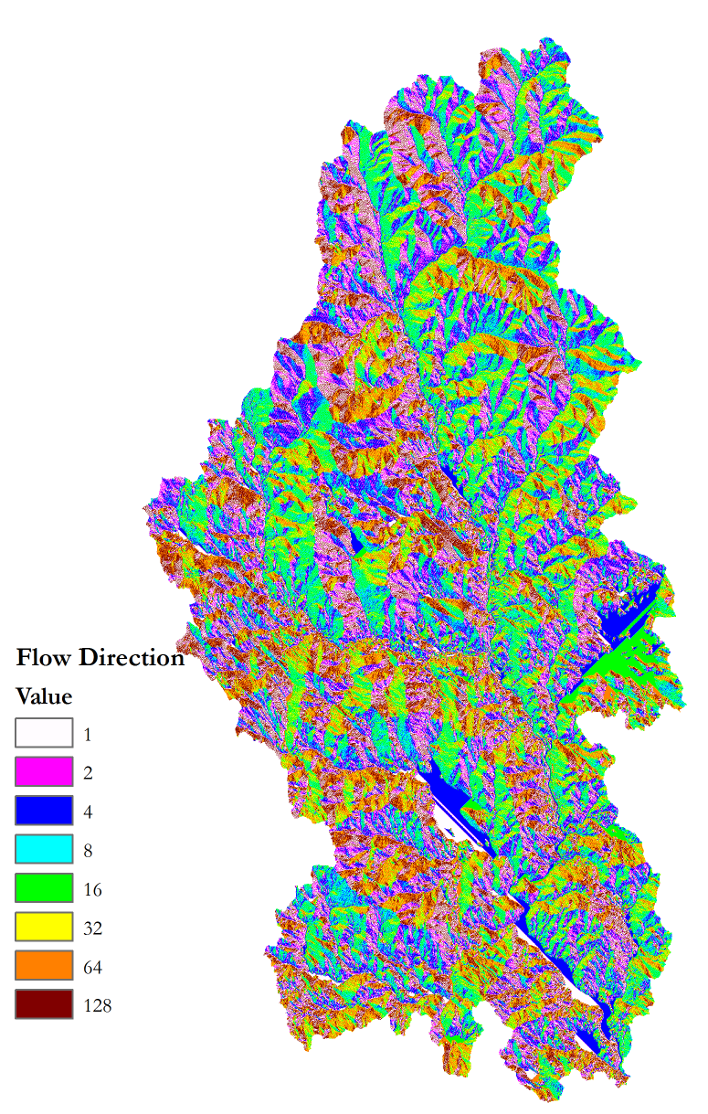
.

Slide 20
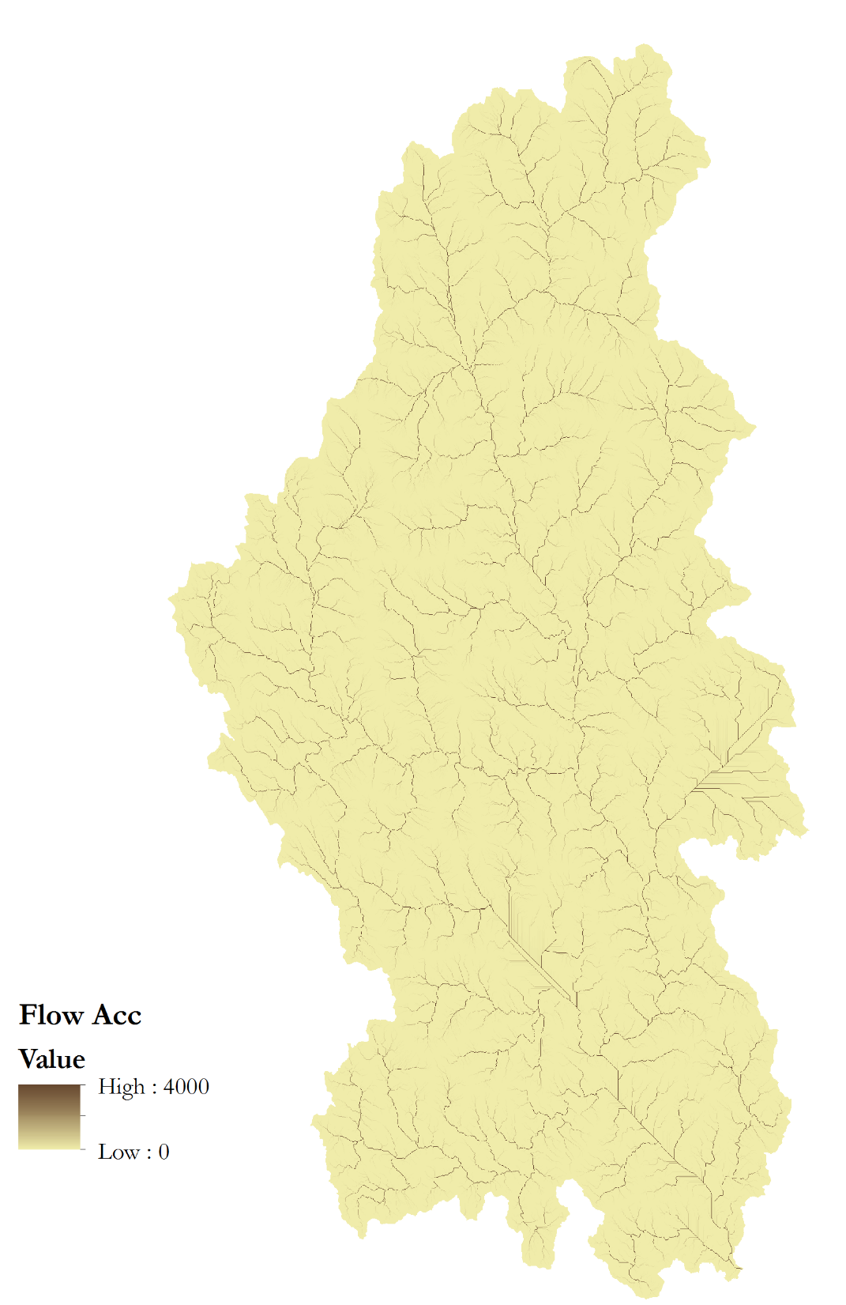
.

Slide 21
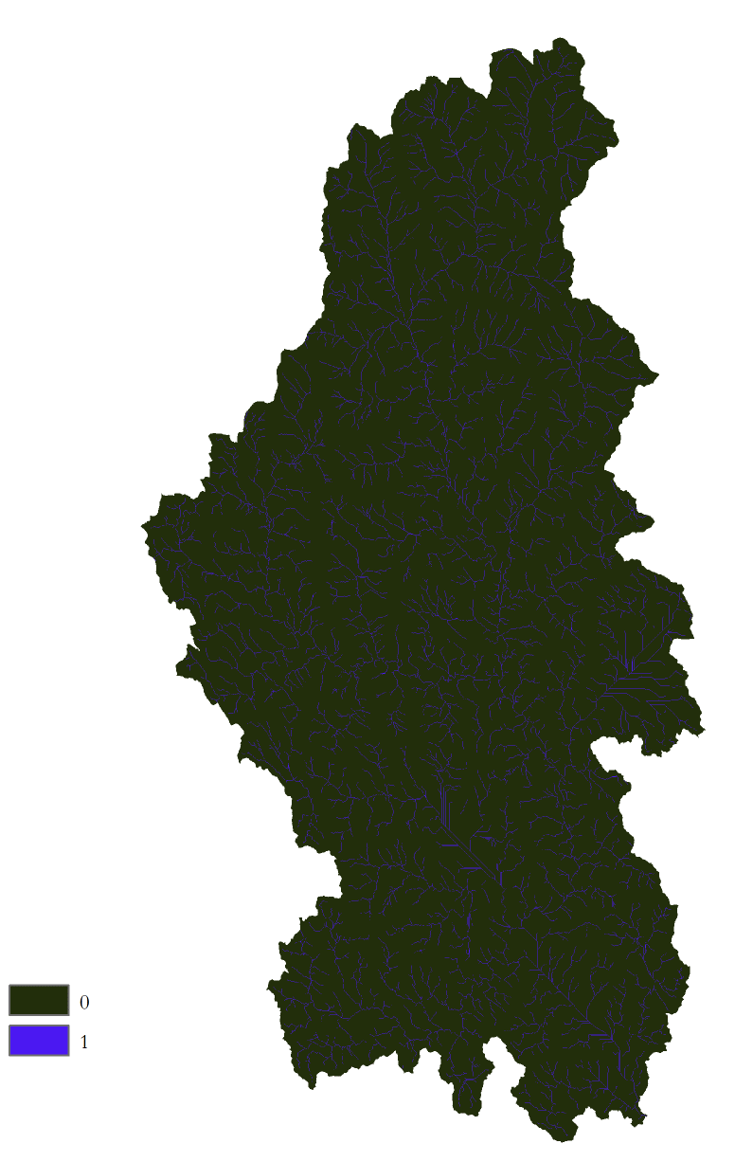
.

Slide 22
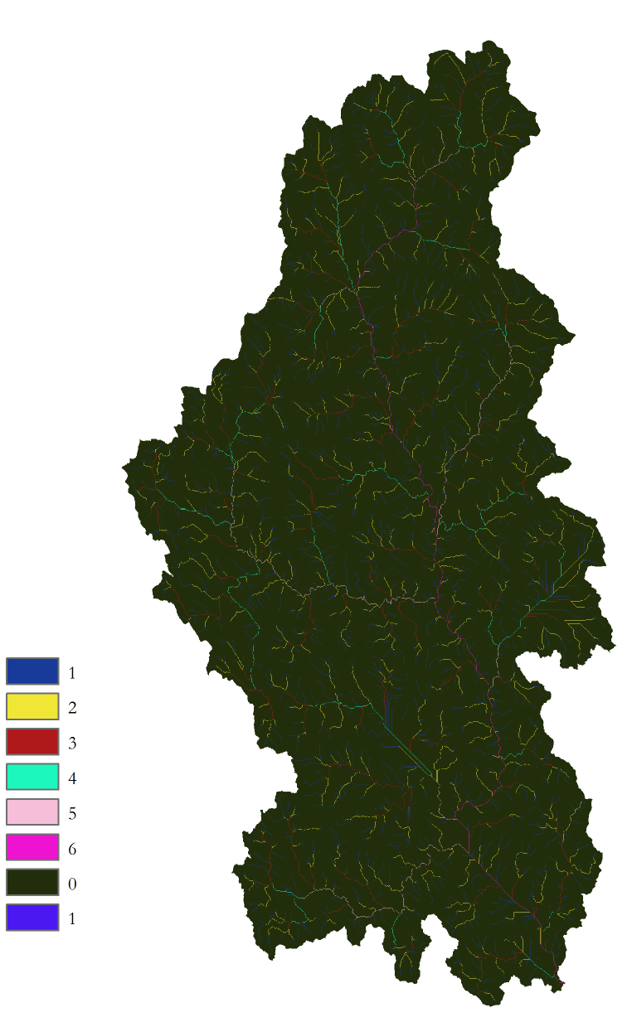
.

Slide 23
Note: Snap Pour Point
Snaps features to the highest localized raster cell. Not necessary if extreme care is taken when features are placed but doesn’t usually hurt.

Slide 24



